Slide 1

Sendy Data Analysis Case Study
Orders Cancellation analysis and prediction by
Mary Dancilla Wanjiru
Submission by 30th July 2019

Slide 2
Overview of Sendy Order Cancellations

Slide 3
Sendy aims to be the preferred logistics platform for helping you grow your business in Africa. It deals with both E-commerce and enterprise delivery.
It ensures its the best platform partnering with Drivers and Businesses to ensure they deliver anywhere at anytime, favourable costs and makes sure goods are protected.
Sendy has experienced that customers are cancelling orders and the presentation below informs how this has occurred as well as some insights drawn from the analysis done to reduce order cancellation.

Slide 4
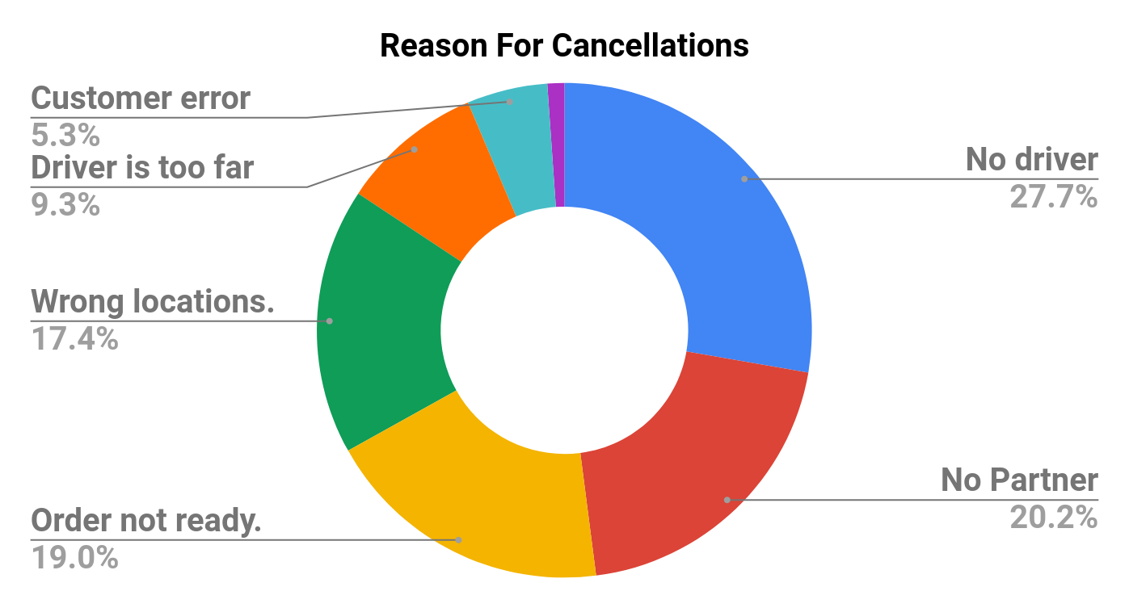
Distribution of Cancellation Reasons
Cancellation Reason | Count
No driver has been allocated to my request. | 1773
No Partner | 1293
My order is not ready. | 1212
I placed the wrong locations. | 1113
The driver is too far away. | 594
Customer error | 337
Delay | 71
Total | 6393
Table 1
Fig 1
With a total of 6393 cancelled orders I have observed that 'No driver has been allocated to my request' value on cancel reasons has the highest count of 1773 that is 27.7% of the total reasons.

Slide 5
Type of order Cancelled

Slide 6
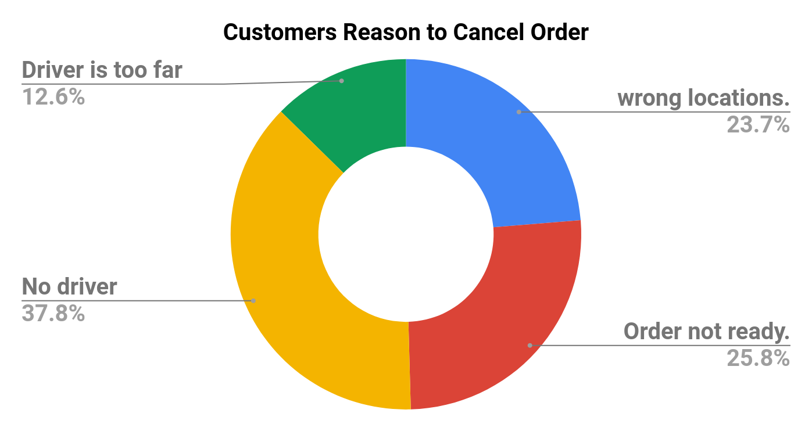
Distribution of Cancellation Reasons - Continued
Cancellation Reason | Customer | Staff
Customer error | 0 | 337
Delay | 0 | 71
I placed the wrong locations. | 1113 | 0
My order is not ready. | 1212 | 0
No Partner | 0 | 1293
No driver has been allocated to my request. | 1773 | 0
The driver is too far away. | 594 | 0
Table 2
Fig 2
No driver has been allocated to my request was the most common cancellation reason for customers. The pairing of driver to to customers should be improved to avoid cancellations.
Staff cancelled 1293 requests because they was no partner. This should be checked to reduce cancellations.

Slide 7
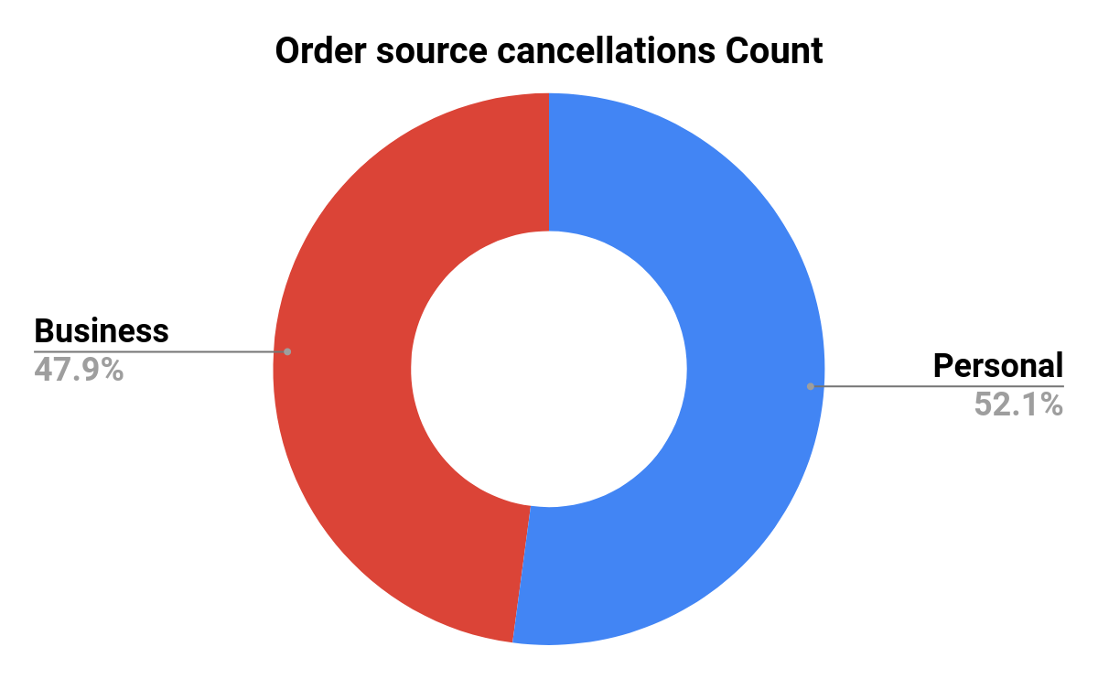
Cancellations per source of request
Cancellation reason | Business | Personal
Customer error | 242 | 95
Delay | 35 | 36
Wrong locations | 566 | 548
Order not ready. | 626 | 588
No Partner | 825 | 468
No driver | 693 | 1082
Driver is too far | 77 | 517
Fig 3
Table 3
It can be observed that there is a high count of cancellation of orders from the business and individuals was mainly due to no partner, order not being ready, wrong location and no driver. This issues should be looked into and improved with urgency. This will greatly reduce the cancellation requests.

Slide 8
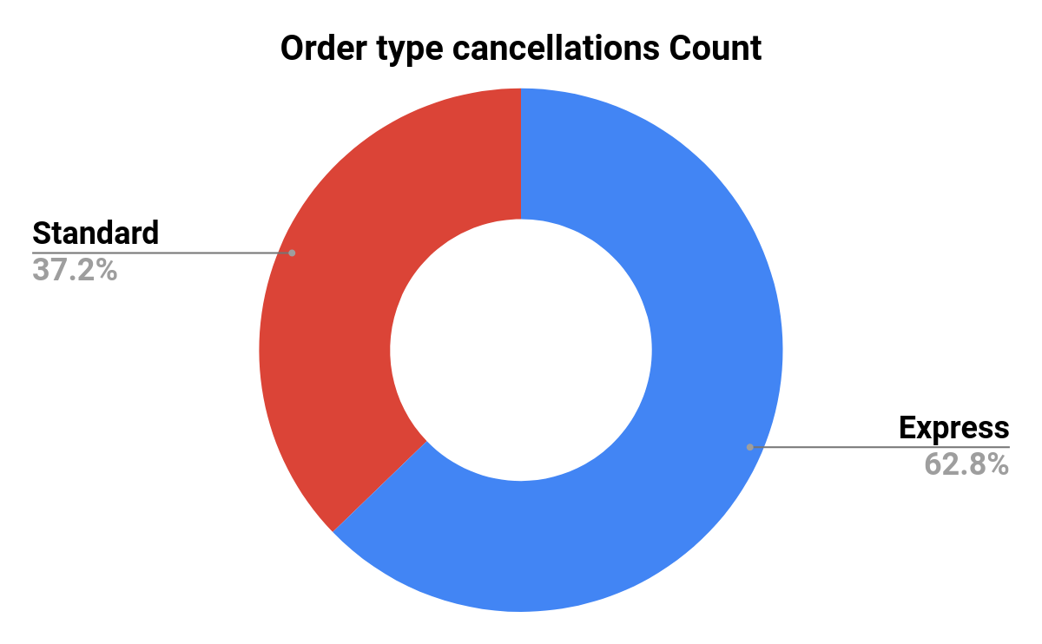
Cancellations per order type
cancel_reason | Express | Standard
Customer error | 245 | 92
Delay | 32 | 39
Wrong locations | 778 | 335
Order not ready. | 854 | 358
No Partner | 810 | 483
No driver | 980 | 793
Driver is too far | 314 | 280
Fig 4
Table 4
There are more orders cancelled on the Express type of orders to the standard orders by 62.8% with a total of 4013 order to 2380 respectively.This was particularly due to orders not being ready and no partner.

Slide 9
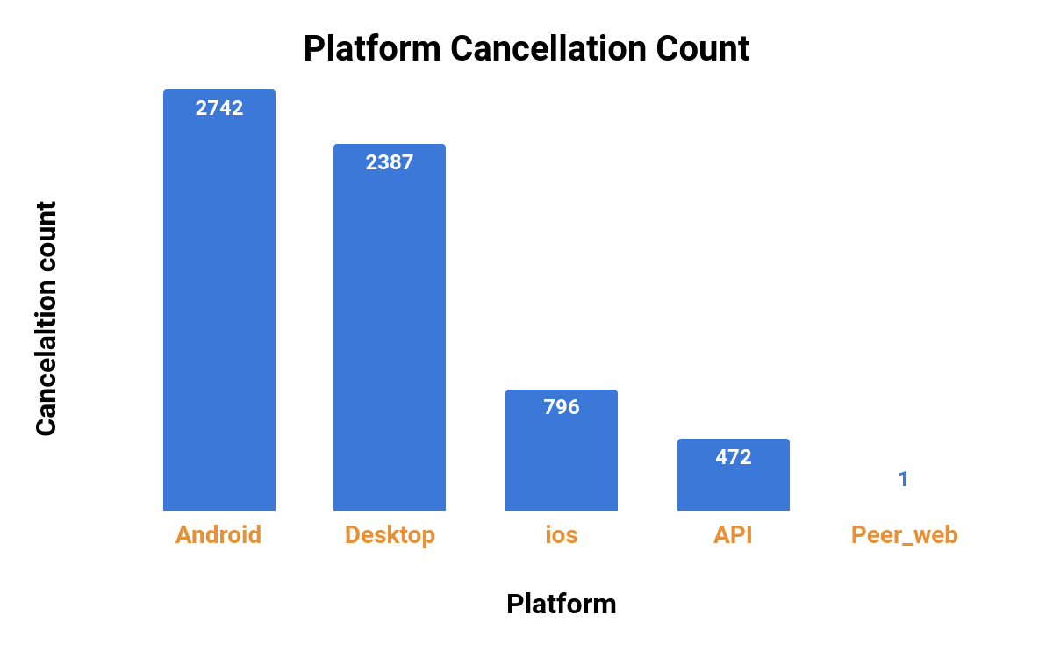
Cancellation per platform
Fig 4
We can observe that many cancellation were made using android devices followed by the desktop application. This may also shows the two platforms are most common. Hence reducing cancellation on them is vital

Slide 10
Cancellation per platform - Continued
Platform | Customer error | Delay | Wrong locations | Order not ready | No Partner | No driver | Driver too far
Android | 69 | 18 | 518 | 504 | 323 | 840 | 470
Desktop | 116 | 34 | 471 | 560 | 517 | 679 | 10
ios | 23 | 16 | 124 | 150 | 114 | 255 | 114
API | 129 | 3 | 0 | 0 | 339 | 1 | 0
Peer_web | 0 | 0 | 1 | 0 | 0 | 0 | 0
Table 5
No driver has been allocated to my request was the leading cause of cancellation across all the platforms.
Improving driver allocation, pairing of partners and order readiness. Would greatly reduce order cancellations.
An investigation needs to be done to find out why desktop platform is leading on order not ready and no partner categories

Slide 11
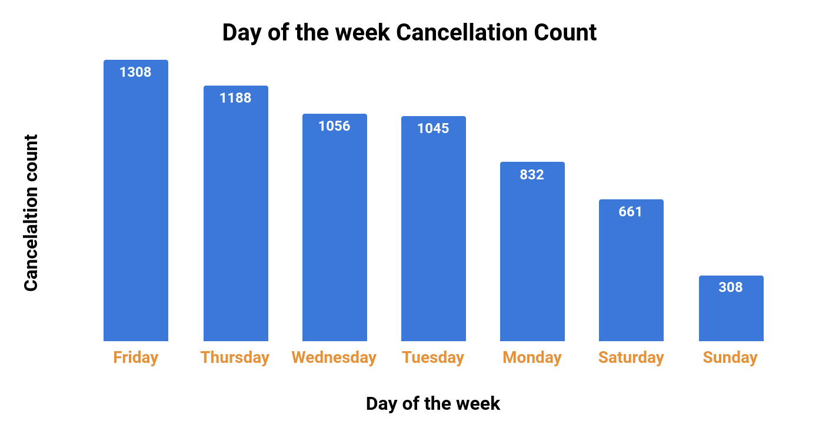
Cancellation per day of the week
Fig 5
Friday and Thursday have the highest recorded cancelled orders. This shows that the have the highest placed orders since delivery is done at the same day. This days should be looked into and resolved to reduce order cancellation and improve order requests.

Slide 12
Cancellation per day of the week - Continued
cancellation_day | Customer error | Delay | Wrong locations | Order not ready | No Partner | No driver | Driver too far
Monday | 42 | 13 | 175 | 174 | 140 | 222 | 66
Tuesday | 56 | 5 | 178 | 217 | 232 | 250 | 107
Wednesday | 46 | 17 | 177 | 222 | 215 | 292 | 87
Thursday | 63 | 9 | 231 | 229 | 243 | 293 | 120
Friday | 111 | 17 | 222 | 223 | 271 | 360 | 104
Saturday | 19 | 10 | 91 | 106 | 129 | 236 | 70
Sunday | 0 | 0 | 40 | 43 | 63 | 122 | 40
Table 6
Thursday and Friday mainly on reasons of no drivers and no partners rank the highest on cancelled orders.
Wrong locations and orders not ready are other reasons ranking high on cancellations orders.
Improving allocation of drivers and providing more partners will reduce order cancellation. Businesses should ensure orders are ready for delivery to aid reducing order cancellation.

Slide 13
Average of some features used
Mean pickup_lat : -1.287768,
pickup_long : 36.814969
Mean distance traveled (in km):' 13.930861880181448
Mean number of cancellation days : 3.6740184576880965

Slide 14
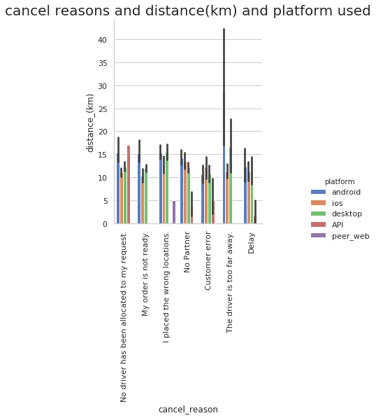
Distribution of platforms used, by which customers and cancellation reasons in (km)
Platforms | Business | Personal
API | 472 | 0
Android | 384 | 2358
Desktop | 2127 | 255
Ios | 76 | 720
Peer Web | 0 | 1
Table 6
Androids have the highest cancel orders as on the table above. On plot it shows it's mainly because drivers were too far as per the distance count. Addressing drivers allocation at a close by distance will reduce cancellation greatly.
Fig 6

Slide 15
Vehicle Type

Slide 16
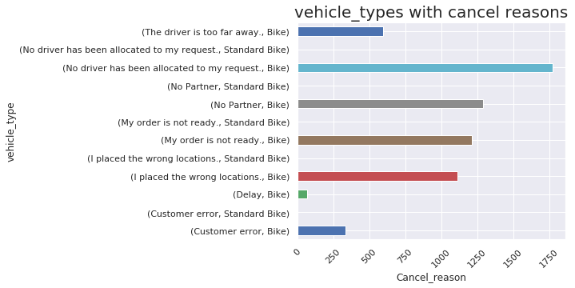
Vehicle Cancelled orders
Fig 7
Order are mostly placed on bikes and it can be observed that No driver has been allocated to my request was the main issue. This is an important factor to resolve.

Slide 17
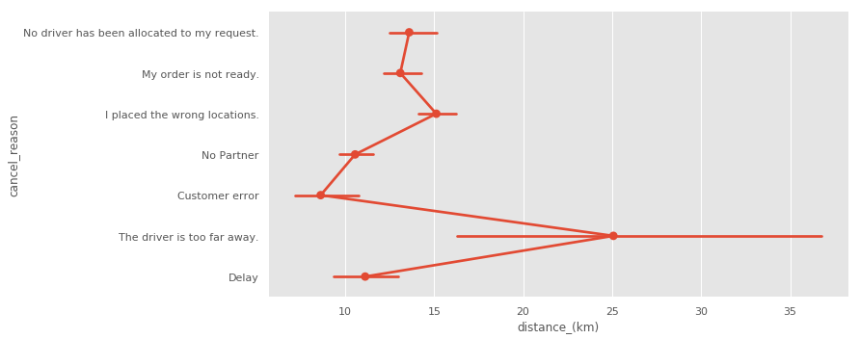
Distance
There were 10 orders made at a distance of 200 km through express order. Their main reason for cancellation was the driver is too far away. This shows that deliveries should be done from a close proximity to the customers thus have more delivery centres.
Fig 8

Slide 18
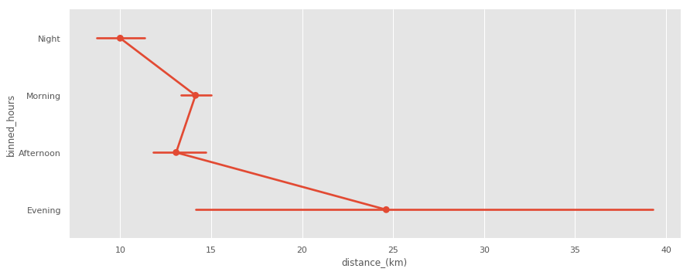
Distance-Continued
Fig 9
The fig. 9 shows that most orders of longer distance were recorded during the evening. More efficient delivery should be adressed at this time.

Slide 19
Time of the day

Slide 20
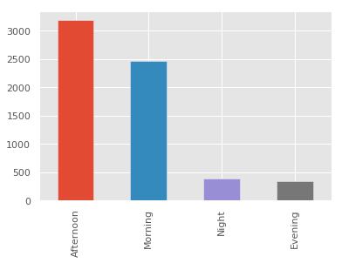
Time of the day
Most orders were cancelled during the morning and afternoon hours. This is a vital point to resolve to reduce cancelled orders.
Morning | 6am -11.59am
Afternoon | 12pm-17.59pm
Evening | 18pm23.59pm
Night | 12am-5.59 am
Fig 9

Slide 21
Time of the day-Continued
More orders are mostly cancelled during the afternoon and morning hours. Morning 6am -11.59am, Afternoon 12pm-17.59pm. This should be looked into resolved.

Slide 22
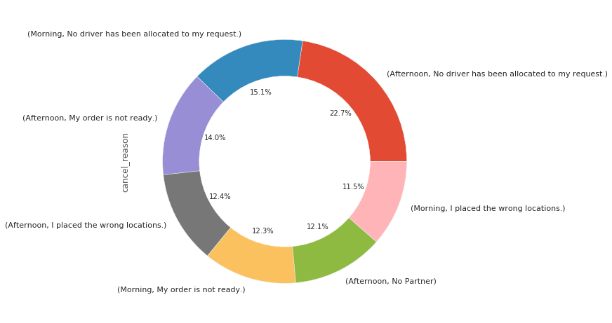
Time of the day-Continued
Fig 10
The Fig 10 shows main reasons during the morning hours and afternoon were due to No allocation of drivers and orders were not ready

Slide 23
Conclusion
Most cancelled orders are mainly due to No driver being allocated, no partner and orders not ready.
This are vital points to look into to reduce order cancellation.

Slide 24
Recommendations
Improve on the driver allocation by allocating drivers who are at a close distance with the customer so as to reduce the number of customers cancelling orders due to the waiting time and improve reliability.
Provide more pick up points to reduce the the distance for the driver thus making the deliveries efficient and faster.
Ensure efficient allocation of more drivers and partners to ensure reduction of cancelling orders
Look into why there are many orders cancelled on Desktop Platforms.
Ensure that the express delivery is seamless as the delivery is to a particular customer.
Provide price charges to evaluate if the price of delivery can be a huge factor of cancellation of orders.

